Slide 1
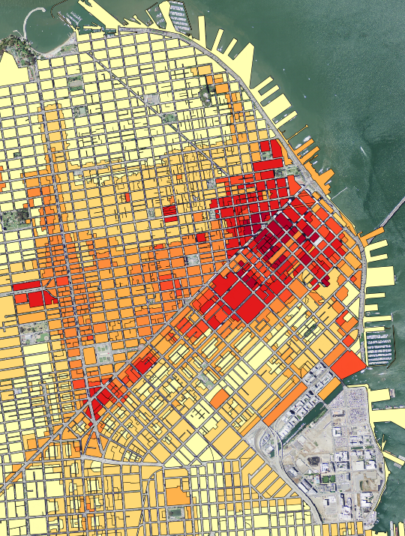

Intro to PostGIS
Daniel Caldwell

Slide 2
What is PostGIS
Extension to PostgreSQL
Provides Spatial Types
Provides Spatial Functions

Slide 3
History of PostGIS
2001 - Refractions Research Releases PostGIS
2003 – GEOS is released
2005 – Version 1.0 Released
2006 – OGC registered PostGIS as implementing SFSQL Specification
2006 - Move from the OpenGIS design guide to the SQL/MM document. ST_ naming conventions added.
2010 – Geography Types Released
2012 – Verson 2.0 Released adding more 3d support, geometry repair, and other functions
October 2015 – Version 2.2.0 released

Slide 4
Things you need to know
Coordinate Systems
Geometries
Spatial Functions

Slide 5
Geometries
Geometry
Coordinate System
GeometryCollection
Point
MultiPoint
LineString
MultiLineString
Polygon
MultiPolygon
There are other geometries for curves, 3d, and measure values

Slide 6
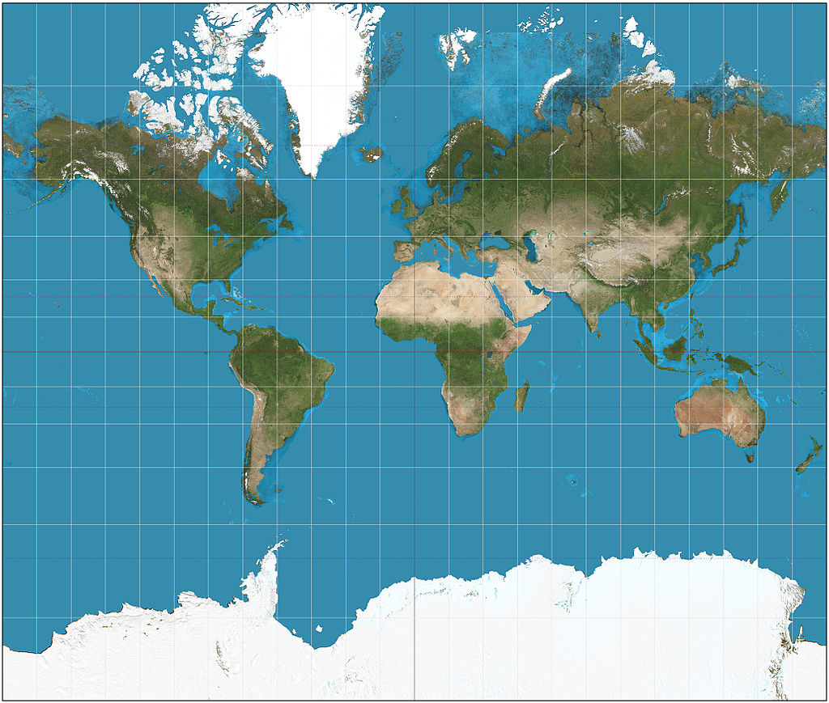

Coordinate Systems

Slide 7
Coordinate System
Helpful Questions to Ask when looking at data
Is it geographic or projected?
If it is geographic is the system 0-360 or -180 to 180?
Where is 0,0?
If it is projected, what are the linear units?

Slide 8
Setup Machine Demo/Exercise
Virtual Machine:
SSH into the vagrant machine: ‘vagrant ssh’
Run script to create database
Connect to PostgreSQL and check version numbers (username/password : geouser/geouser1)
Connect to PostgreSQL using QGIS
AmigoCloud:
Create a project
Create an advanced query to check PostGIS Version

Slide 9
Importing Spatial Data
shp2pgsql
GDAL (ogr2ogr)
QGIS

Slide 10
Importing Data Demo/Exercise
Vagrant Machine
Import states data
Import cities data
Check the coordinate systems
Use psql and fix coordinate systems
AmigoCloud
Upload the zipped state and city data
Run query to identify the spatial reference the data is stored as.

Slide 11
Geometry Validity
Invalid geometries cause problems with spatial operations.
Simple (multipoint and line strings)
no anomalous points (multiple vertices or points at the same place)
No self intersection (loops or figure 8)
No self tangency
Valid (polygons)
No overlapping rings
Interior rings are fully enclosed in the exterior ring
No cut rings
No spikes

Slide 12
Simple vs Not Simple

Slide 13
Valid vs. Invalid

Slide 14
Repair Geometry Demo/Exercise
Vagrant Machine
Import the polygon_test file into postgres
Use psql to check for invalid geometries and repair them.
AmigoCloud
Import the polygon_test zip file.
Notice that the preview image may be incorrect and the data may render wrong
Use advanced queries to identify and repair the invalid geometries

Slide 15
Scenario 1: Identify all Manholes along a street
Geography (meters) vs Geometry (Decimal Degrees)
ST_BUFFER
ST_UNION
ST_INTERSECTS

Slide 16
Demo/Exercise
Take small steps:
Import the manholes and streets
Find street features
Buffer street features
Union buffered geometries
Intersect the single geometry against the manholes

Slide 17
Scenario 2: Identify the closest fire hydrants
ST_DISTANCE
Use Geography to see distance in meters

Slide 18
Demo/Exercise
Import the hydrant data and business data
Select the business 'INFUZON OF THE CASKROOM’ using SQL
Select it’s wkb_geometry
Select the hydrants and the distance to that geometry. Use ST_Distance.
Order and limit the query to the closest three

Slide 19




TileStache
Webserver requests tile from TileStache
TileStache gets image from disk or requests from provider
User requests tiles
Standard URL format: http://server/layer/{z}/{x}/{y}.<extension>

Slide 20

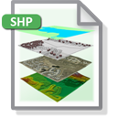
Mapnik
User requests image
Mapnik requests Data from Data Sources. Styles the data and returns image.

Slide 21
Demo/Exercise
Vagrant
Review TileStache config file.
Review Mapnik XML File
Run Scripts for running a tile server.
Change color in Mapnik XML and rerun
AmigoCloud
Make dataset public
Review URL and data
Change color in dataset’s styling pane and review

Slide 22
Further Resources
PostgreSQL (http://www.postgresql.org/)
PostGIS Extension (http://postgis.net/)
GDAL (http://www.gdal.org)
TileStache (http://tilestache.org/)
Mapnik (http://mapnik.org/)
AmigoCloud (http://www.amigocloud.com/)

Slide 23


Thanks!
Daniel Caldwell
daniel@danielcaldwell.com
_DanielCaldwell

